Slide 1
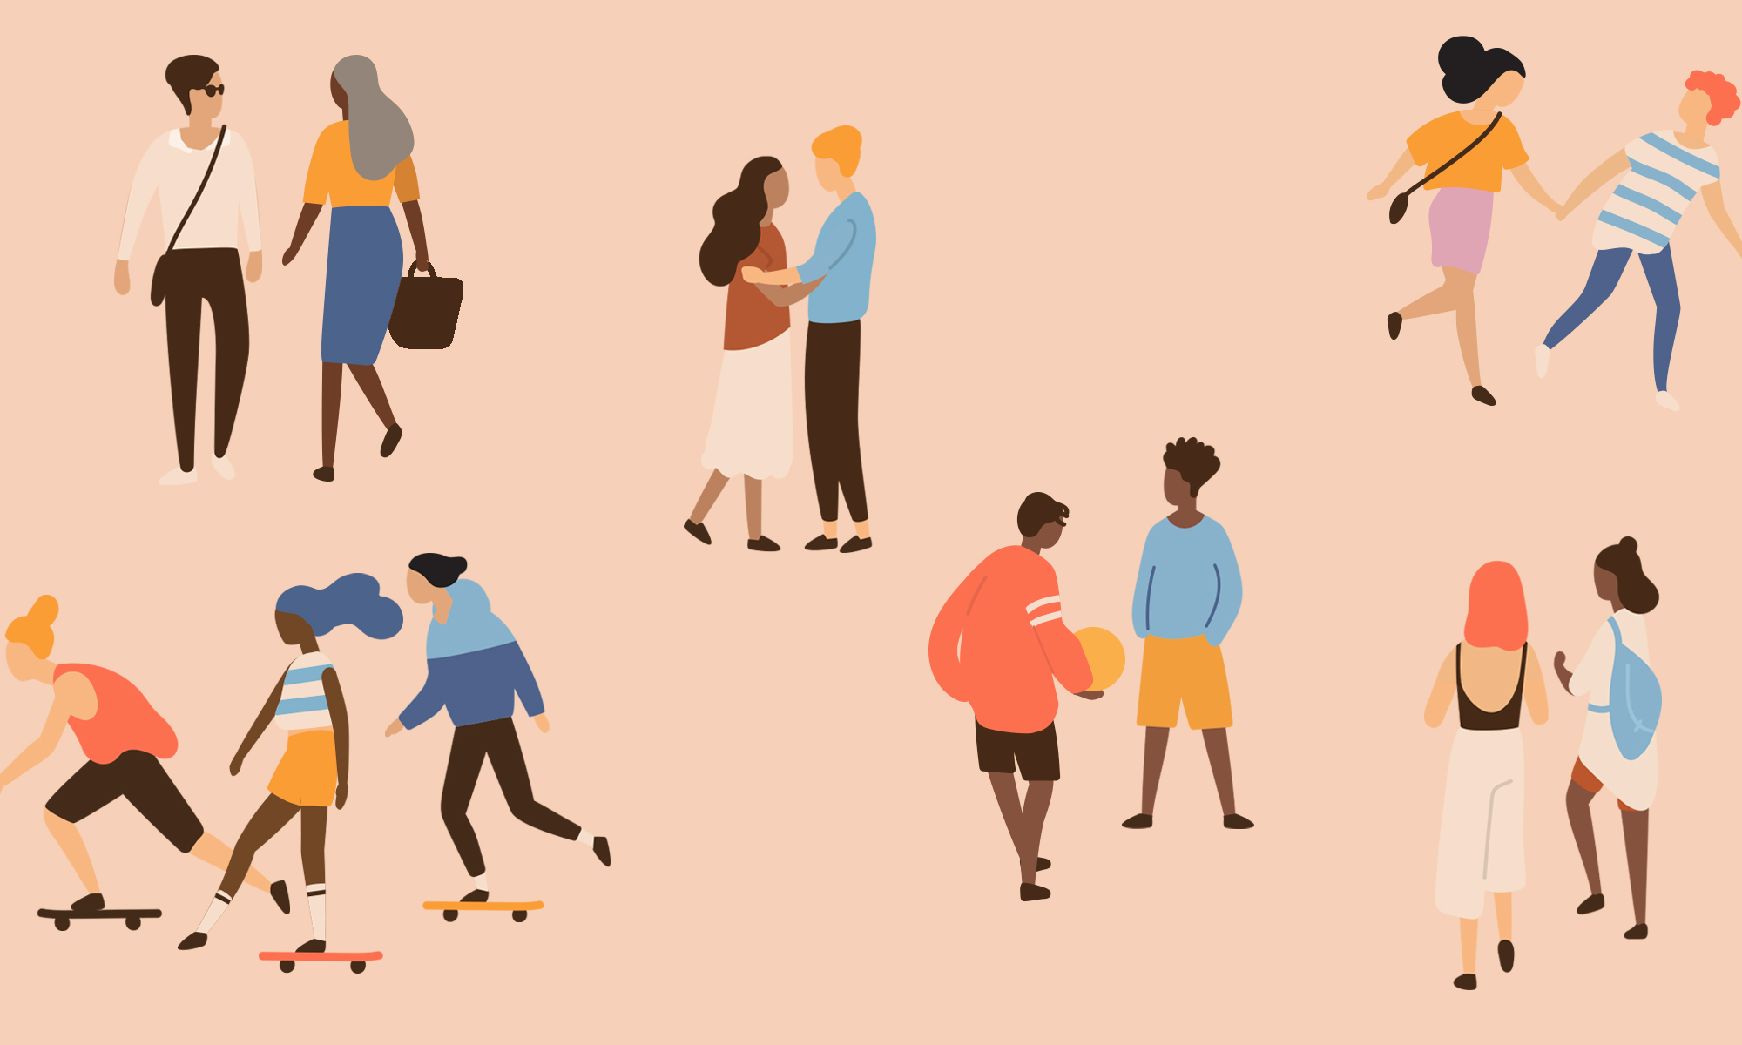
Relationships
Year 10 Health 2024
Lesson 1

Slide 2

Todays Focus:
Understand the requirements of the course & class expectations.
Define the different types of relationships.
Provide examples of the different types of relationships in your own life.
Characterise healthy and unhealthy relationship qualities.

Slide 3

Download Student E-Workbooks
Download Adobe from the internet.
Log onto Connect and go to our class.
Download E-book from term 4 folder.
Open Adobe.
File open E-book from downloads.
Write your name.
File ‘save as’ – save book in folder created for health.
Exit and reopen to be sure your work saved.
Re-open through Adobe, not the internet.

Slide 4
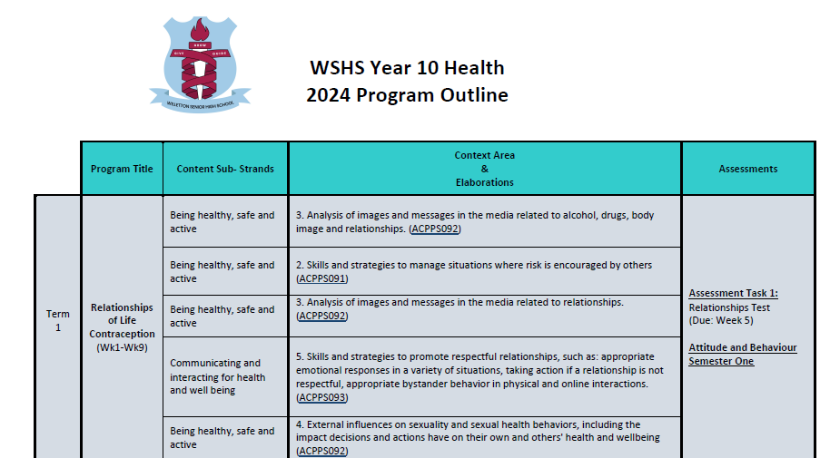

Slide 5
Class Expectations: Think, Pair, Share (pg.6)
You will have 1 minute to THINK about your response to a question.
You will then have 2 minutes to PAIR with the person next to you and discuss your thoughts.
Finally, be prepared to SHARE your thoughts with the class.
This term we will be talking about love, sex, and relationships – keep this in mind when answering the two questions below:
What would you NOT like to see happen?
(i.e., what could go wrong when we talk about these topics?)
What could be implemented in the class so that everyone feels safe, feels that have equal opportunities?
Notes:
Confidentiality, Listening, Don’t use personal stories, Don’t disrespect others
THINK – is it True, is it Helpful, is it Inspiring, is it Necessary, is it Kind
Alternatively, you can complete this in your own way (i.e., brainstorm, post it slam, discussion etc.)

Slide 6
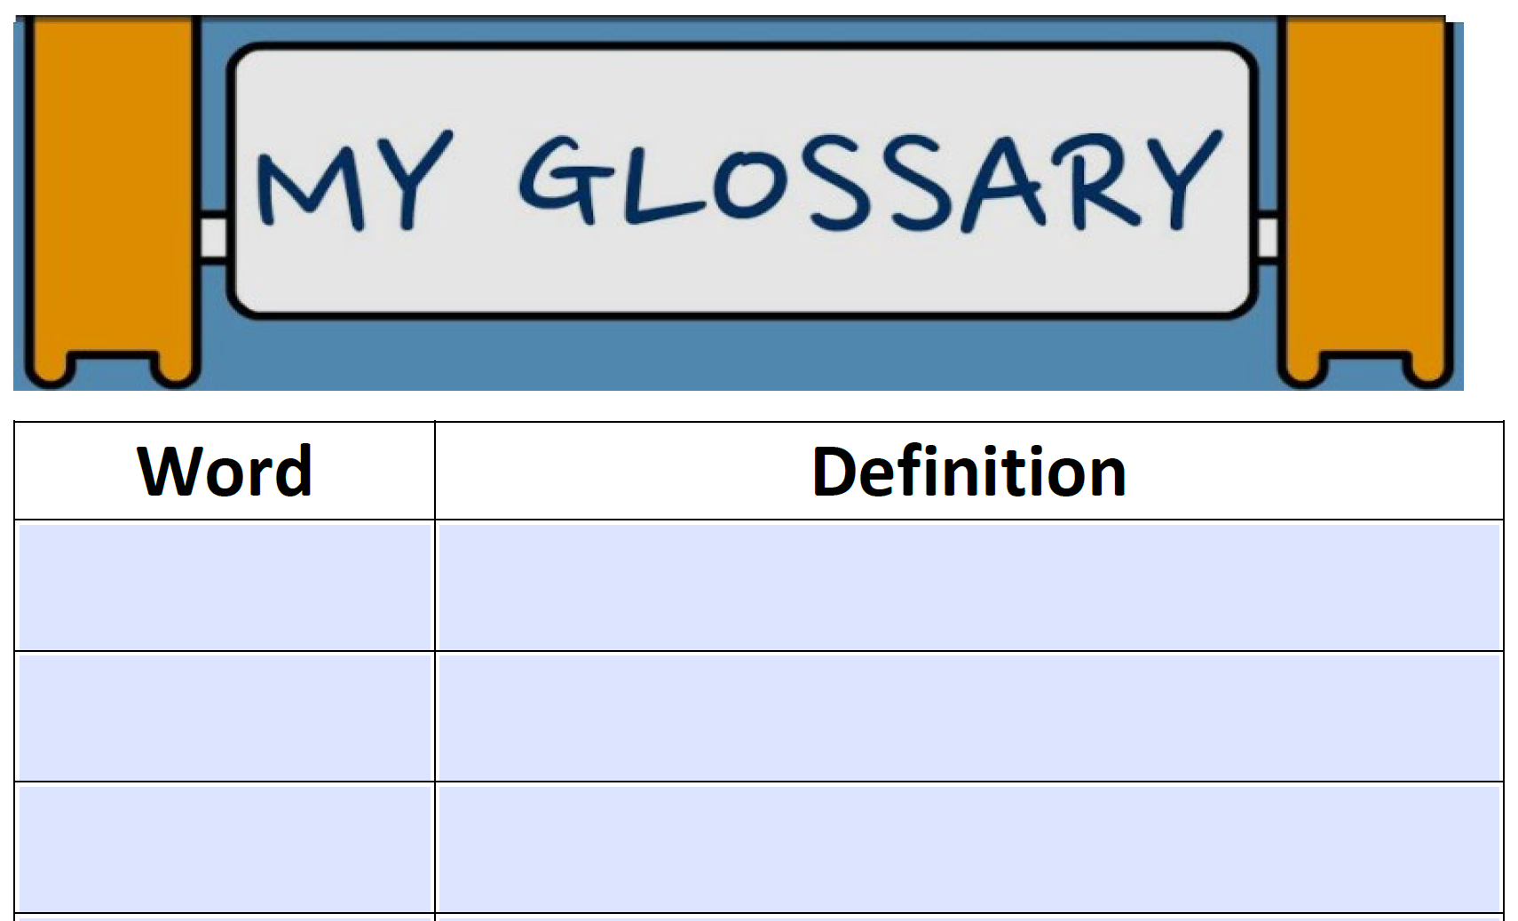

GLOSSARY (pg.7)
Sometimes in health we will use words that you do not understand. Each week, your aim is to write down two new words and their definitions.
You can write down new words that you hear and learn, or your teacher may ask you to add specific words.

Slide 7
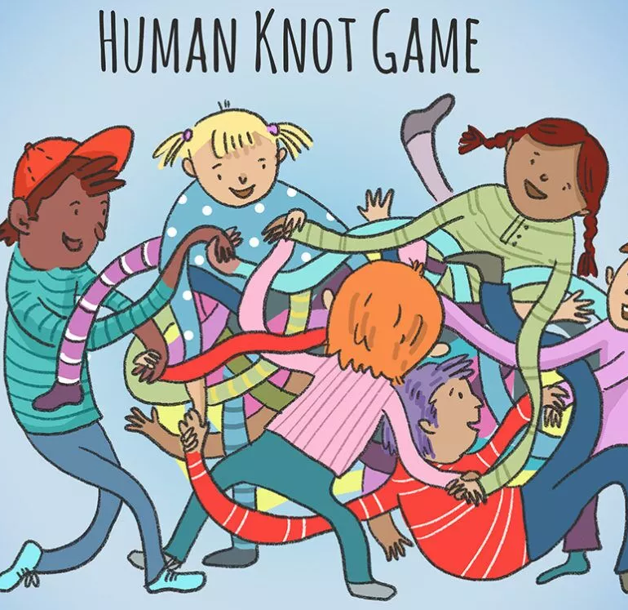
Optional Icebreaker: Human knot
In groups of at least 6 students.
Stand in a circle.
Reach across and hold hands with two different people – they cannot be directly next to you.
CHALLENGE:
Untangle your knot without letting go of each other.
Notes:
Optional
Q: What could the linking of arms and hands represent?
A: The relationship between each other.

Slide 8

Hook: Snowball
Q: What is a relationship?
In one sentence, write your answer to the question on your piece of paper.
Scrunch it up and get ready to throw.
Optional to write your name.
We will read out people’s answers.
Notes:
Resources: scrap paper/blank paper
Students have 1min to write their answer to the above question, followed by 15 seconds to throw their paper around the room. At the end of the 15 seconds, ask students to share what is written on their paper that they have picked up.

Slide 9

Activity 1: Type of Relationships (pg.8)
A relationship is the connection or bond shared between two people.
Consider all the people in your life that you have some sort of connection or relationship with.
Relationships can be categorised into 4 categories:
Friends – someone close, with whom you have a mutual connection.
Family – related by blood or marriage.
Romantic – someone close, with whom you have strong, romantic feelings for.
Acquaintance – a person one knows but is not a close companion.
Consider examples of each of these types of relationships that you have in your life.

Slide 10
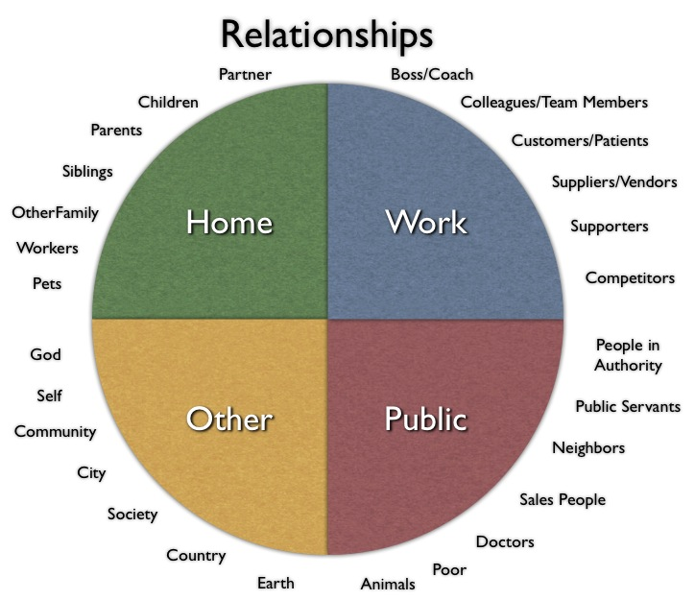
As you can see, there are many different relationships we have in our lives.
These relationships can be classified in many different ways, but it is important to also consider how these relationships serve us in our lives.
Notes:
This is an example of how relationships can still be classified in different ways, and the wide array of relationships and connections we have in our lives.

Slide 11

GLOSSARY: (pg. 7)
At the front of your books is your glossary. Turn to your glossary and add the following words and their definitions:
Relationship:
A connection between two or more people.
Acquaintance:
A person one knows but is not a close companion.
Notes:
Definition of relationships relevant to test

Slide 12

Activity 2: (pg.9) Spider-web of Relationships
Create a mind map of all the different relationships you have in your life.
Branching off each type relationship, write people in your life who fit in with that type.
For each person you have a relationship with, further branch off how that person fits into your life:
How important is that relationship --> 1 (not very important) - 10 (very important)
What does that person/that relationship offer you?
E.g., comfort, stability, adventure, love, frustration etc.
You have 10 minutes.
Notes:
Resources: blank paper → if some students have the ability to draw it on their device they can, otherwise use blank paper.
Optional activity.
Example on next slide.
Limit 2-3 people per type of relationship.

Slide 13
Comfort, safety, adventure, affection, support
Support, help, friendship
10/10
Brother
Mum
Partner
9/10
9/10
Romantic
Family
Unconditional love, support, care, advice
Motivation
My Relationships
Grandparent
Unconditional love, advice, culture and tradition
10/10
Sports Coach
6/10
Acquaintance
Friends
Adventure, fun
9/10
Friend 1
Teacher
Friend 2
8/10
5/10
Learning
Fun, advice, love, non-judgmental support
Notes:
This activity can also help students to become aware of who their support network may be.
E.g.,
A person has a good relationship with their mum, brother and grandparent. They can acknowledge how that relationship benefits them and how they rate it in importance in their life (i.e., mum = 10/10).
For their friends, one friend might be good for advice while another friend is good for adventure and excitement. Both friends are valuable but bring different things to their friendships.
Ask students to be specific with names of people in their life.

Slide 14

Activity 3: (pg.10) Relationship Qualities – Healthy vs. Unhealthy
The relationships we have in our life can serve us in different ways.
They can be healthy, positive and beneficial, or they can be unhealthy, negative and toxic.
While watching the video, consider what you think are healthy qualities in a relationship and unhealthy qualities and write them into the table in your books.
Also think about the relationships in your life and what qualities are present there.
Notes:
Optional to watch the video – can be done without watching.
Relevant to test

Slide 15
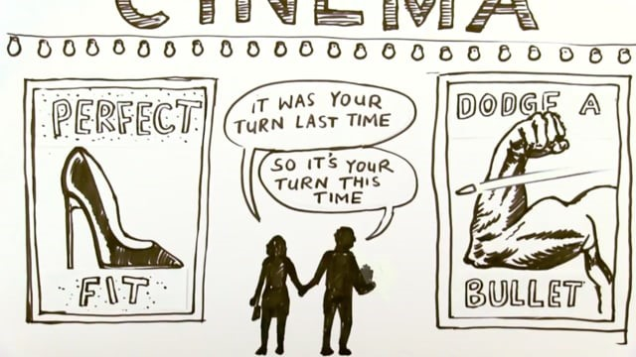
Notes:
Optional – can do the activity without watching the video.
While watching, students add examples of healthy and unhealthy relationship qulaities to the table in their books.
https://vimeo.com/171884861

Slide 16
Activity 3: (pg.10) Relationship Qualities – Healthy vs. Unhealthy
You have 3 minutes to now add anything else to the table.
You can discuss with the person next to you.
Healthy Relationship Qualities | Unhealthy Relationship Qualities
Open Communication
Trust
Equality
Honesty
Common interests
Reflection
Mutual Respect
Belief in each other
Support
Enjoy personal time
Lack of Communication
Cheating
Only spend time with person
No Trust
Jealousy
One sided argument
Inequality
Fear
Controlling
Notes:
Relevant to test

Slide 17
Consider the qualities in this table.
They may help you realise some other examples of qualities that are important to you in your various relationships.
Notes:
Students can use this table to help identify what they value in their relationships.
Table is also in their books.

Slide 18

Reflection: Significant Relationships (pg.11)
Some relationships are more significant than others, and relationships can change over time due to personal circumstances, or be affected by outside influences such as family, peers, culture, religion etc.
Reflect on your relationships and answer the questions below:
List and name the type of important relationships you have.
Which are your most important? Why?
Do you think these may change? Why/not?
How do you think relationships differ when we are 20 vs. 35 vs. 70 years old?
Notes:
Relevant to test

